Slide 1
Mathematical Model Details

Slide 2
Overview
Motor PWM Values
Conversions (If Necessary)
+
PID
Desired Pitch
PID
Appropriate Summations
Duty Cycle to PWM
Drone
-
+
Desired XY Position
-
Desired Roll
+
PID
+
PID
Duty Cycle to PWM
-
-
Desired Yaw
+
PID
Duty Cycle to PWM
-
Estimated XY Position
Desired Elevation
+
PID
Duty Cycle to PWM
-
Sensor Feedback (May need to operations with these when feeding back)

Slide 3
PID Variables
PID
e[]
Array of size ??? holding error values from sampled sensor values.
Most recent value is held at the end(?)
P, I, and D
Gain values for each part of the PID controller.
sum
“Integration” of e[] (see “Integral Details” slide)
slope
“Derivative” of e[] (see “Derivative Details” slide)
dutyCycle
Final output: gives the Duty Cycle of the PWM signal that needs to be generated (valued from 0 to 255, NOT 100. Because that’s the way the 8-bit-resolution-pwm-cookie crème brûlées)

Slide 4
Duty Cycle Calculation
PID
dutyCycle = P*e[last] + I*sum – D*slope
if(dutyCycle > 255) {
dutyCycle = 255;
}

Slide 5
Integral Details
PID
sum will keep track of the integration so far.
for each new sample:
sum += e[last] //assuming the most recent element is in the last position
Additional operations needed to correct overshoot (see “Overshoot Correction”)

Slide 6
Derivative Details
PID
2 Options to solve for slope (2 is probably best)
ACTUALLY, 1 might be best if we downsample before getting error values.
(most recent e) – (2nd most recent e)
Pros:
More responsive
Cons:
Noise can really mess stuff up, and can also be twitchy
(average of N most recent or e[]) – (average of the next N of e[])
Pros:
Resists noise effects
Cons:
Slower response

Slide 7
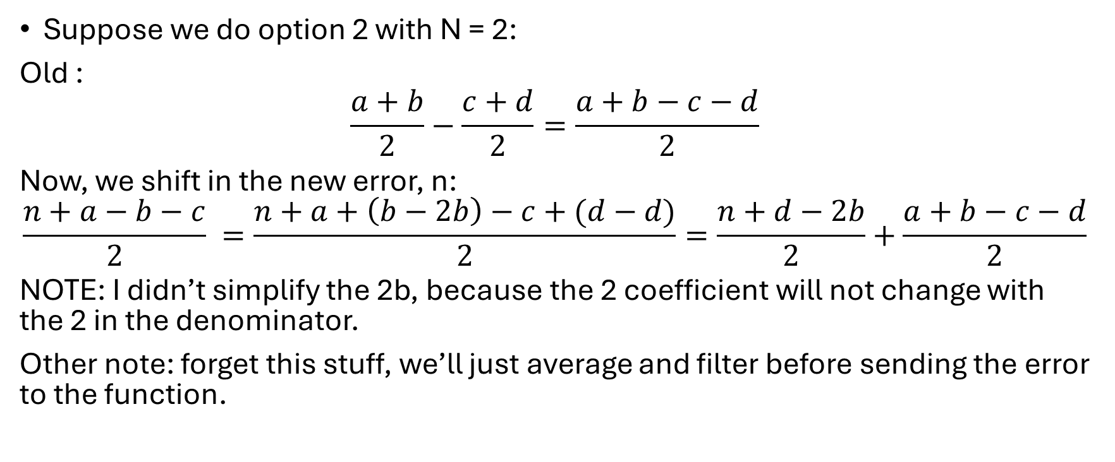
MORE Derivative Details
PID
Suppose we do option 2 with N = 2:
Old :
$$\frac{a+b}{2}−\frac{c+d}{2}=\frac{a+b−c−d}{2}$$
Now, we shift in the new error, n:
$$\frac{n+a−b−c}{2} =\frac{n+a+\left(b−2b\right)−c+(d−d)}{2}=\frac{n+d−2b}{2}+\frac{a+b−c−d}{2}$$
NOTE: I didn’t simplify the 2b, because the 2 coefficient will not change with the 2 in the denominator.
Other note: forget this stuff, we’ll just average and filter before sending the error to the function.

Slide 8
Overshoot Correction
PID
Need to cap sum to some value.
255 would work but we could probably cap it at a smaller value.

Slide 9

Appropriate Summations
Appropriate Summations
M_{fl} = a*Thrust + b*Yaw + b*Pitch + b*Roll
M_{fr} = a*Thrust - b*Yaw + b*Pitch - b*Roll
M_{br} = a*Thrust - b*Yaw - b*Pitch + b*Roll
M_{bl} = a*Thrust + b*Yaw - b*Pitch - b*Roll
Note: a+3b = 1
This should keep the final values between 0 and 255 (crème brûlée)
NOTE: Yaw might need to be scaled differently than Pitch and Roll (might need a, b, and c.)

Slide 10
Duty Cycle to PWM Block
Duty Cycle to PWM
Things to keep in mind:
T_{DutyCycle} <= T_{sample}
T_{DutyCycle} should be some multiple of T_{sample}

